Slide 1
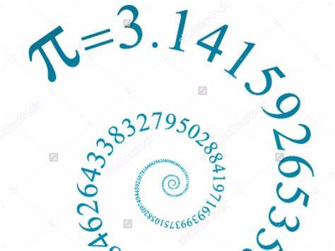
Pi Calculation on Mapreduce
CS570 - Big Data Processing & Analytics
Submitted by: Divya Pandey(19665)
Instructor: Dr. Henry Chang

Slide 2
Table of Content
Introduction
Design
Implementation
Test
Enhancement Ideas
Conclusion
References

Slide 3
Introduction
Pi is one of the most extremely useful and fundamental quantities.
The value of Pi ~ 3.14
It is (ratio of darts that land inside the circle to the total number of darts thrown) times 4
Some examples of daily uses of Pi:
Medicine benefits from pi when studying the structure of the eye
Aircraft designers use it to calculate areas of the skin of the aircraft
Navigation, such as global positioning (GPS)
Nature,Using pi, it can measure things like ocean wave, light waves, sound waves etc

Slide 4
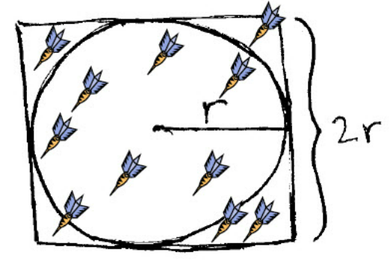
Design
Suppose we take N darts on board. Darts land on board at random position (x,y) on the board.
If x²+y²<r, then dart land inside the circle.
Inside the circle dart is denoted by S.

Slide 5
Design
Pi can be Calculated by (ratio of darts that land inside the circle to total number of darts landed within Square) times 4
Formula:
pi= 4 * (pi * r * r) / (4 * r * r) = 4*S/N

Slide 6
Design
We use MapReduce Algorithm to Calculate value of Pi
Mapper: Generate points in a unit square and then count points inside/outside of the inscribed circle of the square.
Reducer: Accumulate points inside/outside results from the mappers
Get inside/outside results from the mappers

Slide 7
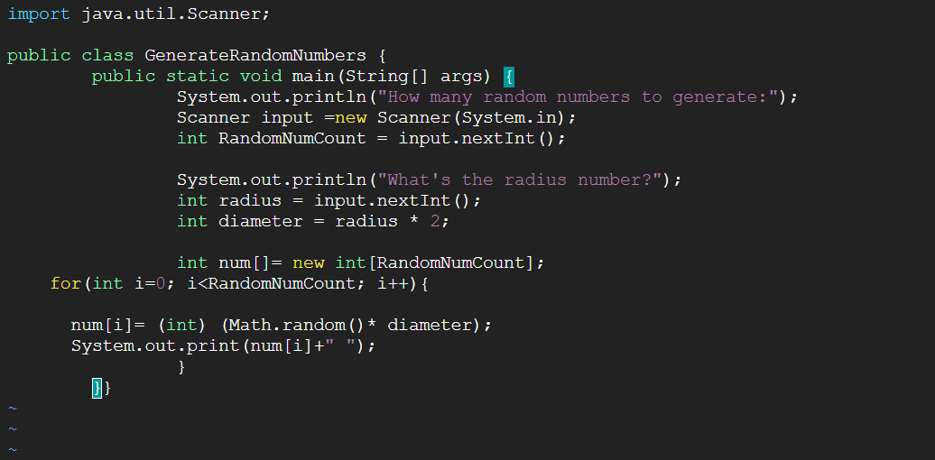
Implementation
Create Java Program to calculate the Random Numbers:
vi GenerateRandomNumbers.java

Slide 8
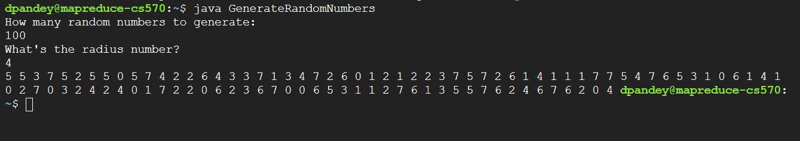
Implementation
Generate the Random number and Save as input file for Hadoop Job

Slide 9
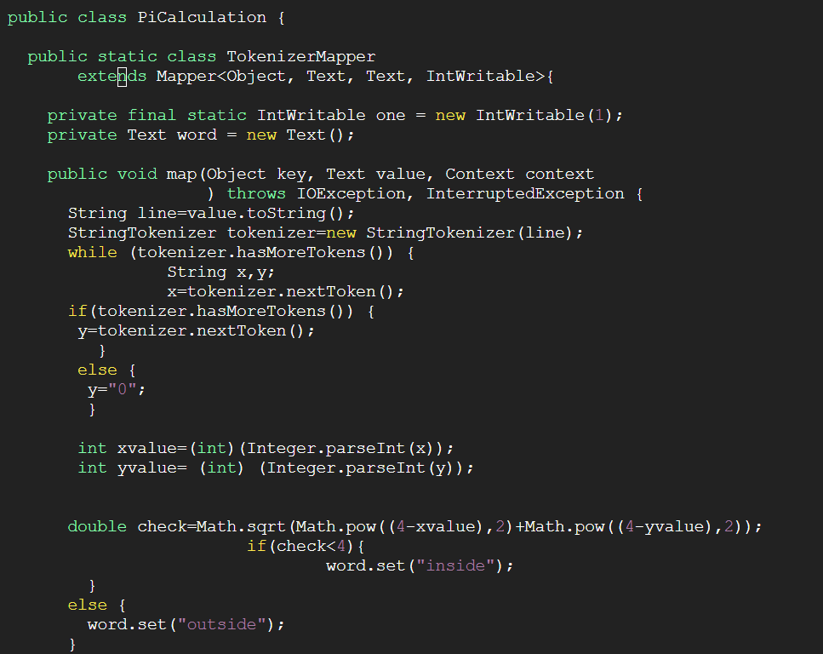
Implementation
Create PiCalculation.java file to perform MapReduce Operation(Radius=4)
map function()

Slide 10
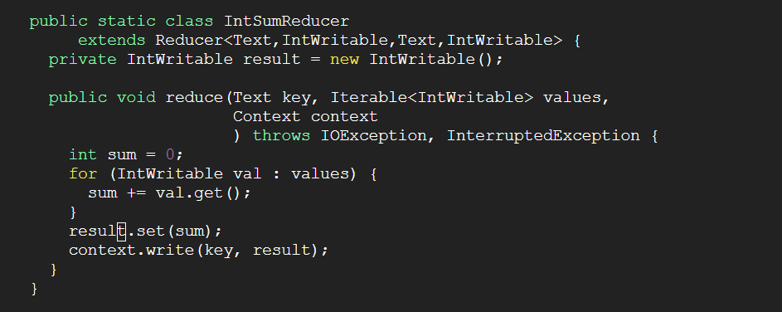
Implementation
Create PiCalculation.java file to perform MapReduce Operation(Radius=4)
reduce function()

Slide 11
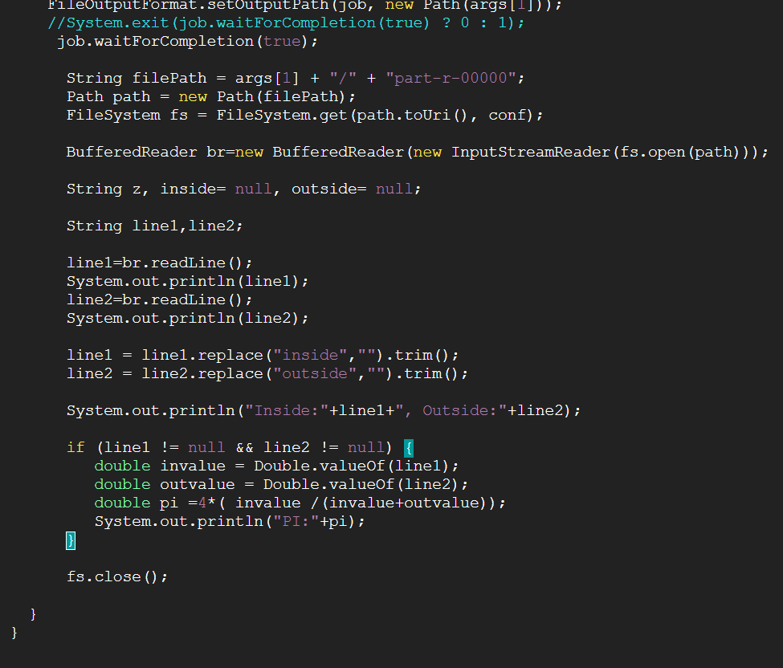
Implementation
Create PiCalculation.java file to perform MapReduce Operation
main function()

Slide 12
Test
Go to hadoop directory
cd hadoop-3.3.4
hadoop namenode -format //Format Hadoop namenode
sbin/start-dfs.sh //start hadoop components
Create HDFS Directories:
bin/hdfs dfs -mkdir /user
bin/hdfs dfs -mkdir /user/dpandey
bin/hdfs dfs -mkdir /user/dpandey/picalc
bin/hdfs dfs -mkdir /user/picalc/input

Slide 13
Test
Upload the input folder on HDFS in the specific directory
bin/hdfs dfs -put ../PiCalculation/input/* picalc/input
Run the jar file for PiCalculation.java
bin/hadoop com.sun.tools.javac.Main ../PiCalculation/PiCalculation.java
cp ../PiCalculation/*.class .
cp ../WordCount/*.java .
jar cf pi.jar PiCalculation*.class

Slide 14
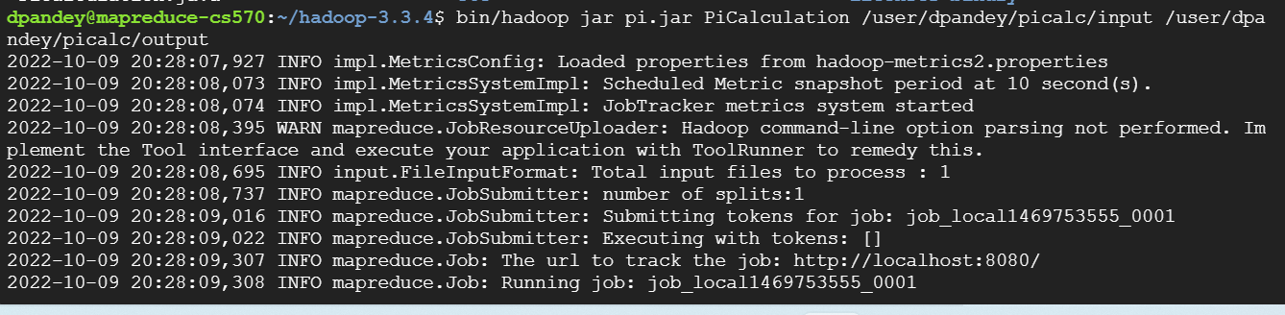
Test
Run Hadoop Job:
bin/hadoop jar pi.jar PiCalculation /user/dpandey/picalc/input /user/dpandey/picalc/output

Slide 15
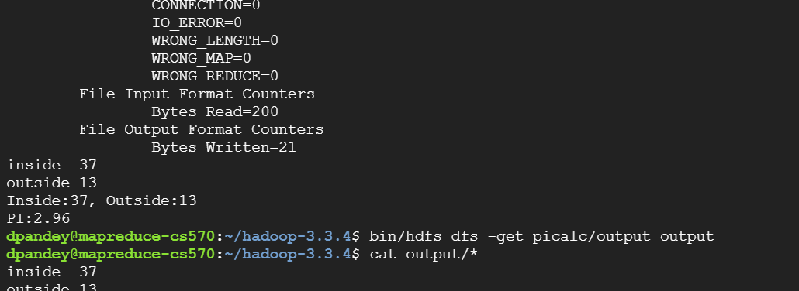
Test
Mapreduce result (darts inside, outside the circle and PI value)

Slide 16
Enhancement Ideas
Pi Calculation from Mapreduce Operation can also performed on the following cloud computing environment:
AWS
Azure

Slide 17
Conclusion
When we take large sample of data i.e random value more than 1 million, pi value nearly estimated to 3.14250000000000000000

Slide 18
References
2.1.5 mapreduce example: Pi Estimation & Image smoothing - module 2: Large scale data storage. (n.d.). Retrieved October 10, 2022, from https://www.coursera.org/lecture/cloud-applications-part2/2-1-5-mapreduce-example-pi-estimation-image-smoothing-8mfUV
Real life application of pi. (n.d.). Retrieved October 10, 2022, from https://amazingarchimedes.weebly.com/real-life-application-of-pi.html

